Slide 1
Gradient Importance Learning for Incomplete Observations Qitong Gao, Dong Wang, Joshua D. Amason, Siyang Yuan, Chenyang Tao, Ricardo Henao, Majda Hadziahmetovic, Lawrence Carin, Miroslav Pajic Xiaohan Cheng February 3, 2022
Notes:
This paper was written one year ago.

Slide 2
Background
Consider learning from incomplete datasets. Components of the data could be missing for various reasons.
This phenomenon is prevalent in the healthcare domain, mostly in the context of electronic health records (EHRs), which are structured as patient-specific irregular timelines with attributes, across patients for any arbitrary time point.
Examples: Surveys, Diagnosis, Laboratory test
Notes:
for instance, missing responses from participants, data loss, issues like restricted access.
e.g., diagnosis, laboratory tests, thus resulting in high missingness
May be Surveillance test is another example

Slide 3
Flaws of Current Methods
Existing works tackle this problem by either proposing imputation algorithms (IAs) to explicitly produce estimates of the missing data, or by imposing imputation objectives during inference.
Require additional modeling assumptions for the underlying distributions or formatting of the data
Other applications depend on domain knowledge for pre-processing and modeling
Introduce additional information-based losses
Generative methods could result in imputations with high variation
Notes:
Consider learning from incomplete datasets. Components of the data could be missing for various reasons.
Existing works tackle this problem by either proposing imputation algorithms (IAs) to explicitly produce estimates of the missing data, or by
imposing imputation objectives during inference, e.g., withholding observed values as being
the ground-truth and learning to impute them.
However, some of these either require additional modeling assumptions for the underlying distributions (Bashir and Wei, 2018;
Fortuin et al., 2020), or formatting of the data
introduce additional information-based losses which are usually intractable with real-world data. Moreover,
generative methods could result in imputations with high variation (e.g., low confidence of the output distribution), when data have high
missingness rates or small sample sizes.

Slide 4
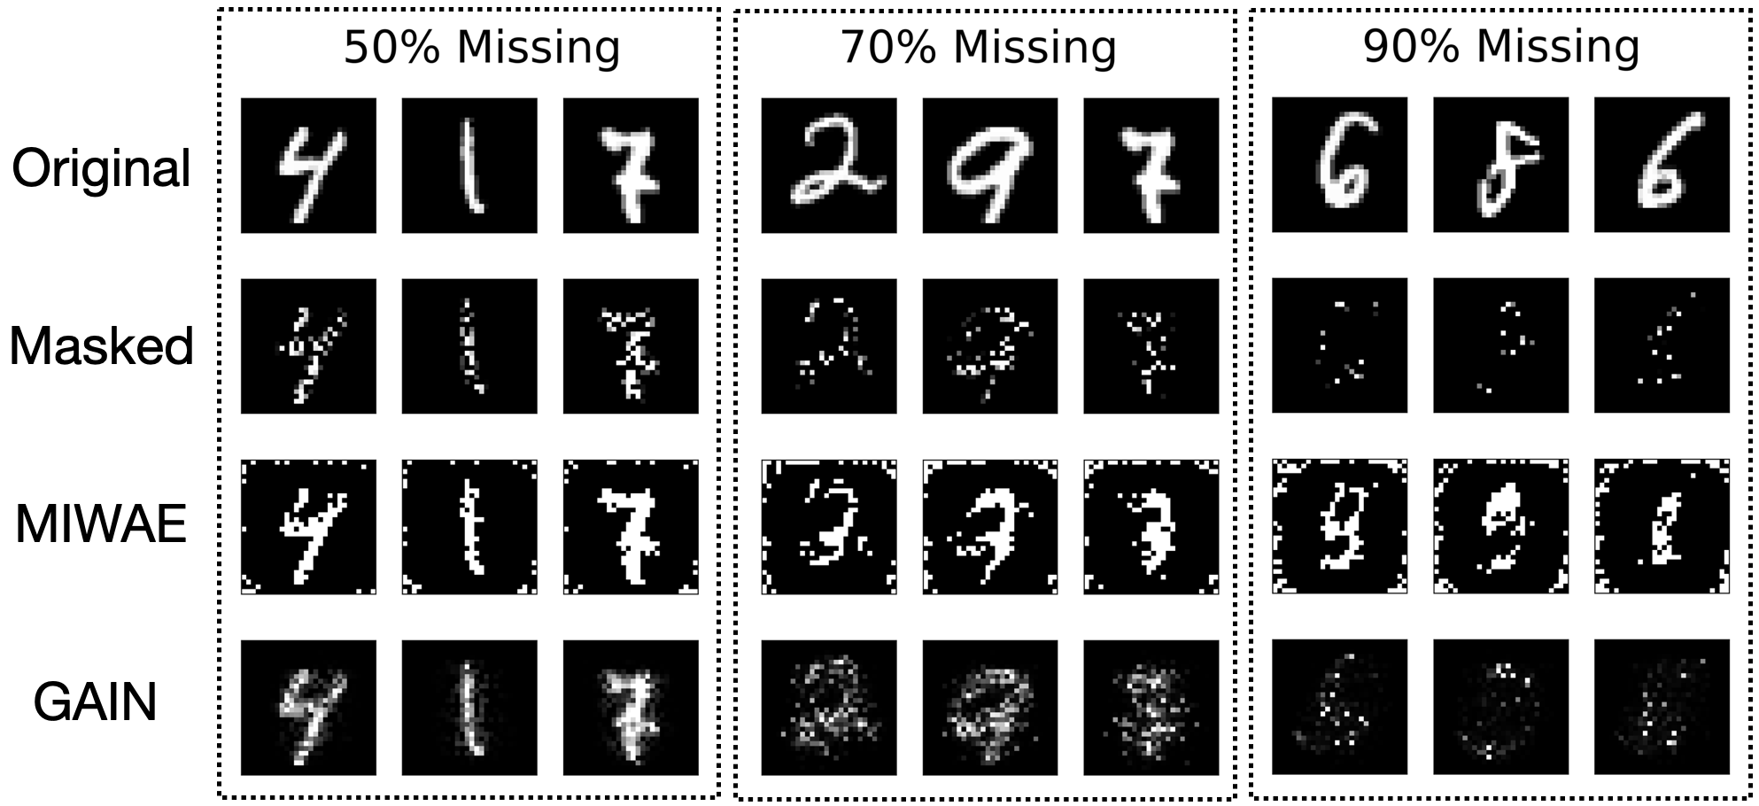
Example
Figure 1: MNIST digits imputed by state of-the-art imputation methods MIWAE (Mattei and Frellsen, 2019), GAIN (Yoon et al., 2018).
Notes:
Figure 1 illustrates imputations generated by two state-of-the-art deep generative models on the MNIST dataset with 50%, 70% and 90% of the pixels set as missing (i.e., masked out). It is observed that both approaches suffer from inaccurate reconstruction of the original digits as the missingness rate increases,
which is manifested as some of the imputed images not being recognizable as digits.
Importantly, the error introduced by the imputation process can be further propagated into downstream inference and prediction stages.

Slide 5
Motivation for Gradient Importance Learning
Imputing the missing data is, in most cases, not necessary
Considering where and when the data are missing can be intrinsically informative.
In both cases, the missingness patterns are indicative of the underlying condition of both patients.
Propose the gradient importance learning (GIL) method, which facilitates an imputation-free learning framework for incomplete data by simultaneously leveraging the observed data and the information underlying missingness patterns.
Patient | Infection | Culture test/panel specific to bacterial infections | RT-PCR test/panel specific to viral infections
A | Bacterial infection |  | Much fewer orders (and results)
B | Viral infection | Much fewer orders (and results)
Notes:
Consider a scenario in which two patients, A and B, admitted to the intensive care unit (ICU) suffer from bacterial and viral infections, respectively, and assume that the healthcare provider monitors the status of the patients by ordering two (slightly) different blood tests daily, namely, a culture test/panel specific to bacterial infections and a RT-PCR test/panel specific to viral infections. Hence, patient A is likely to have much fewer orders (and results) for viral tests. In both cases, the missingness patterns are indicative of the underlying condition of both patients. Moreover, such patterns are more commonly found in incomplete data caused by missing at random (MAR) or missing not at random (MNAR) mechanisms, which usually introduce additional difficulties for inference.

Slide 6
Contributions of Gradient Importance Learning
The first work that trains deep learning (DL) models to perform accurate imputation-free predictions with missing inputs.
Unlike existing approaches that require additional modeling assumptions or that rely on methods (or pre-existing knowledge) that intrinsically have advantages over specific types of data, our method does not require any assumptions or domain expertise.
Facilitates feature learning from incomplete data, as the importance matrix can guide the hidden layers of the model to capture information underlying missingness patterns during training, which results in more expressive features.
Notes:
(i) This allows models to effectively handle high missing rates, while significantly reducing the prediction error compared to existing frameworks which use imputation.
(ii)Consequently, it can consistently achieve top performance over a variety of data and under different conditions. I will show the results later.
(iii)The proposed framework also

Slide 7
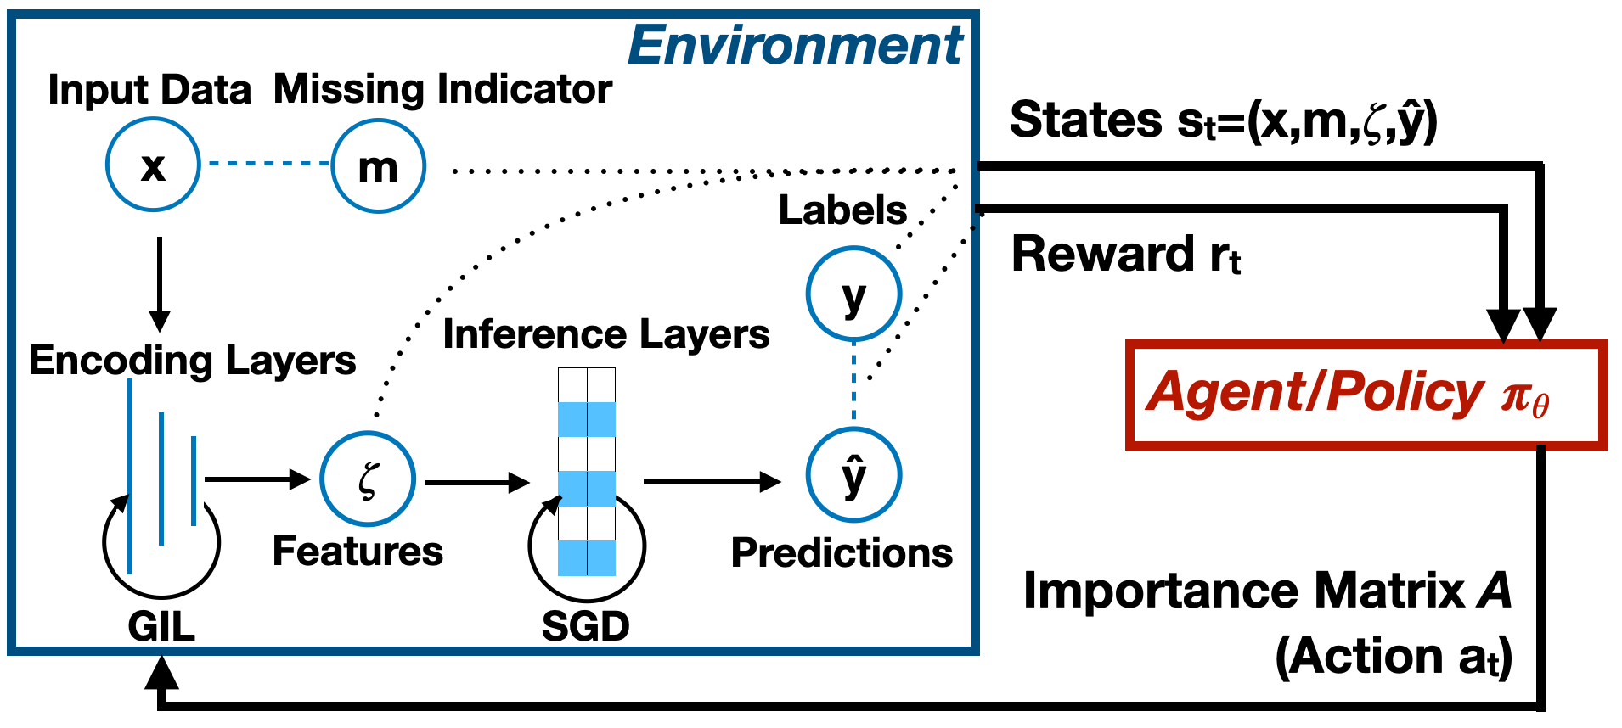
Overview of Gradient Importance Learning
Propose to use an importance matrix to weight the gradients that are used to update the model parameters in the back-propagation process
Propose to generate the importance matrix using a reinforcement learning (RL) policy on-the-fly.
Notes:
Specifically, we propose to use an importance matrix to weight the gradients that are used to update the model parameters in the
back-propagation process, after the computational graph of the model is settled, which allows the model to exploit the information
underlying missingness without imputation.
However, these gradients cannot be tracked by automated differentiation tools such as Tensorflow (Abadi et al., 2016).
So motivated, we propose to generate the importance matrix using a reinforcement learning (RL) policy on-the-fly.
This is done by conditioning on the status of training procedure characterized by the model parameters, inputs and model performance at the current training
step.
Concurrently, RL algorithms are used to update the policy by first modeling the back-propagation process as an RL environment, or a Markov decision process (MDP). Then,
by interacting with the environment, the RL algorithm can learn the optimal policy so the importance matrix can aid the training of the prediction models to attain desirable performance.
GIL; a method that facilitates training of imputation-free prediction models with incomplete data.
we show how the gradient descent directions can be adjusted using the importance matrix A. In Section 2.3, we introduce an RL framework to generate the elements of A which can leverage the information underlying missingness during training, as illustrated in Figure 2.

Slide 8
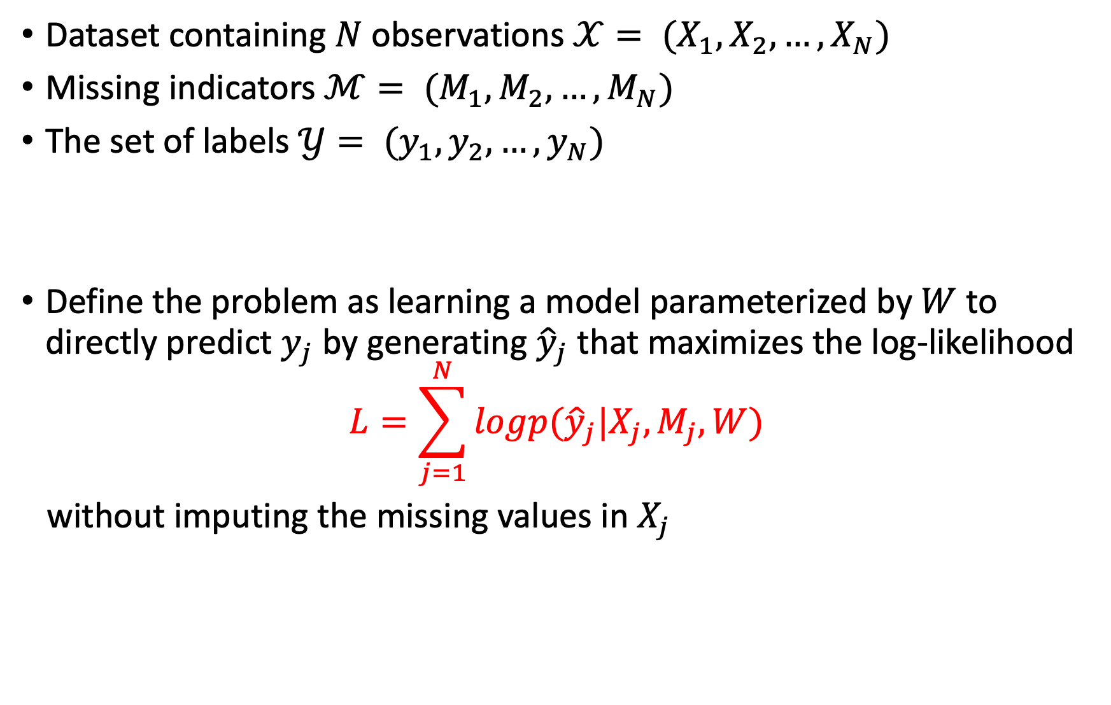
Problem Formulation
Dataset containing $N$ observations $𝒳= (X_{1},X_{2},…,X_{N})$
Missing indicators $ℳ= (M_{1},M_{2},…,M_{N})$
The set of labels $𝒴= (y_{1},y_{2},…,y_{N})$
Define the problem as learning a model parameterized by $W$ to directly predict $y_{j}$ by generating ${\hat{y}}_{j}$ that maximizes the log-likelihood
$$L=\sum_{j=1}^{N}{logp({\hat{y}}_{j}|X_{j},M_{j}, W)}$$
without imputing the missing values in $X_{j}$
$${M_{j}∈{\left\{0, 1\right\}}^{T×d} X}_{j}={\left[\begin{matrix}x_{11} & ⋯ & x_{1d} \\ ⋮ & ⋱ & ⋮ \\ x_{T1} & ⋯ & x_{Td}\end{matrix}\right]}_{T×d}$$
Notes:
We consider a dataset containing N observations X = (X1;X2; : : : ;XN) where each Xj can be represented by a vector xj 2 Rd (for tabular data) or a matrix Xj 2 RTj d (for
time-series) with Tj denoting the time horizon of the sequence Xj . Since the focus of this work is principally on time-series data, recurrent neural networks will receive significant
attention. We also define the set of missing indicators M = (M1;M2; : : : ;MN), where Mj = mj 2 f0; 1gd or Mj 2 f0; 1gTj d depending on the dimension of Xj , and 0’s (or 1’s) correspond to the entries in Xj that are missing (or not missing), respectively. Finally, we assume that each Xj is associated with some label yj 2 Y; thus Y = (y1; y2; : : : ; yN) denotes the set of labels.
Tabular data is data that is structured into rows, each of which contains information about some thing.

Slide 9
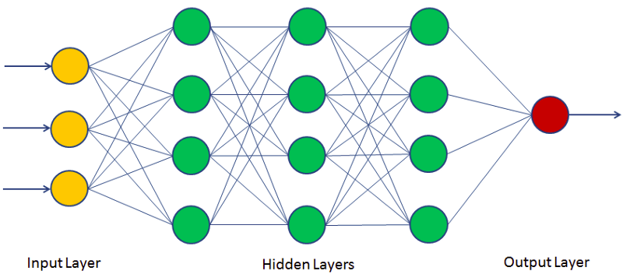
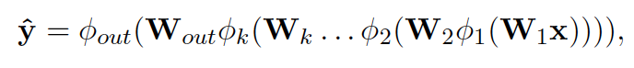
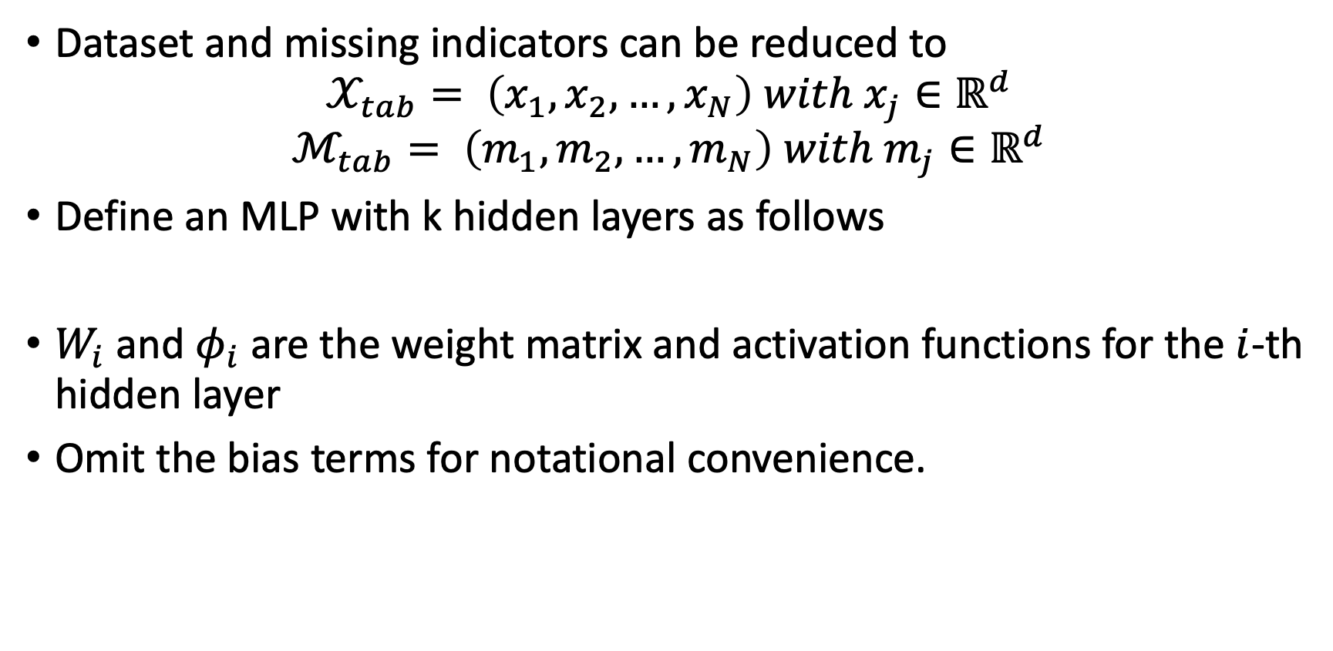
Gradient Importance
Importance matrix can be applied to gradients, which are produced by taking regular stochastic gradient descent (SGD) steps, toward training multi-layered perceptron (MLP) models with incomplete tabular inputs
Dataset and missing indicators can be reduced to
$$𝒳_{tab}= \left(x_{1},x_{2},…,x_{N}\right) with x_{j}∈ℝ^{d}$$
$$ℳ_{tab}= \left(m_{1},m_{2},…,m_{N}\right) with m_{j}∈ℝ^{d}$$
Define an MLP with k hidden layers as follows
$W_{i}$ and $φ_{i}$ are the weight matrix and activation functions for the $i$-th hidden layer
Omit the bias terms for notational convenience.
Notes:
Missingness is a common issue found in tabular data and time series
multi-layered perceptron (MLP) (Bishop, 2006) and long short-term memory (LSTM) (Hochreiter and Schmidhuber, 1997) models, respectively, are often considered for predictions.
Note that this idea can be easily extended to sequential inputs with LSTM models and the corresponding details can be found in Appendix A.
xj 2 Rd and mj 2 Rd

Slide 10
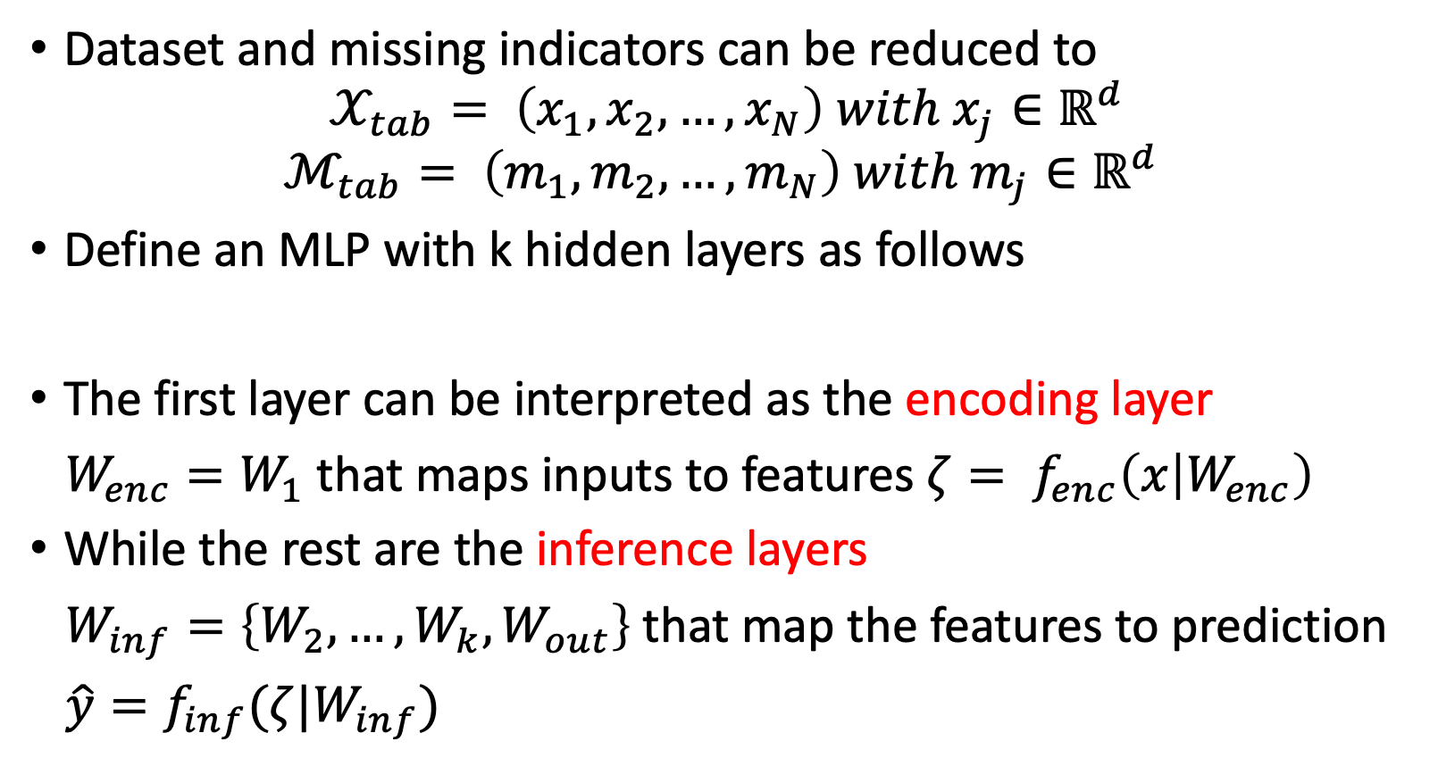
Gradient Importance
Dataset and missing indicators can be reduced to
$$𝒳_{tab}= \left(x_{1},x_{2},…,x_{N}\right) with x_{j}∈ℝ^{d}$$
$$ℳ_{tab}= \left(m_{1},m_{2},…,m_{N}\right) with m_{j}∈ℝ^{d}$$
Define an MLP with k hidden layers as follows
The first layer can be interpreted as the encoding layer
$W_{enc}=W_{1}$that maps inputs to features$ζ= f_{enc}\left(x | W_{enc}\right)$
While the rest are the inference layers
$W_{inf}=\left\{W_{2},…,W_{k},W_{out}\right\}$that map the features to prediction
$\hat{y}=f_{inf}(ζ|W_{inf})$

Slide 11
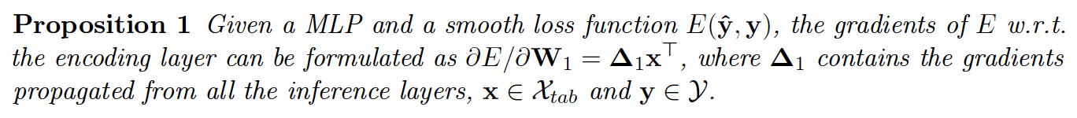
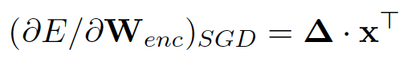
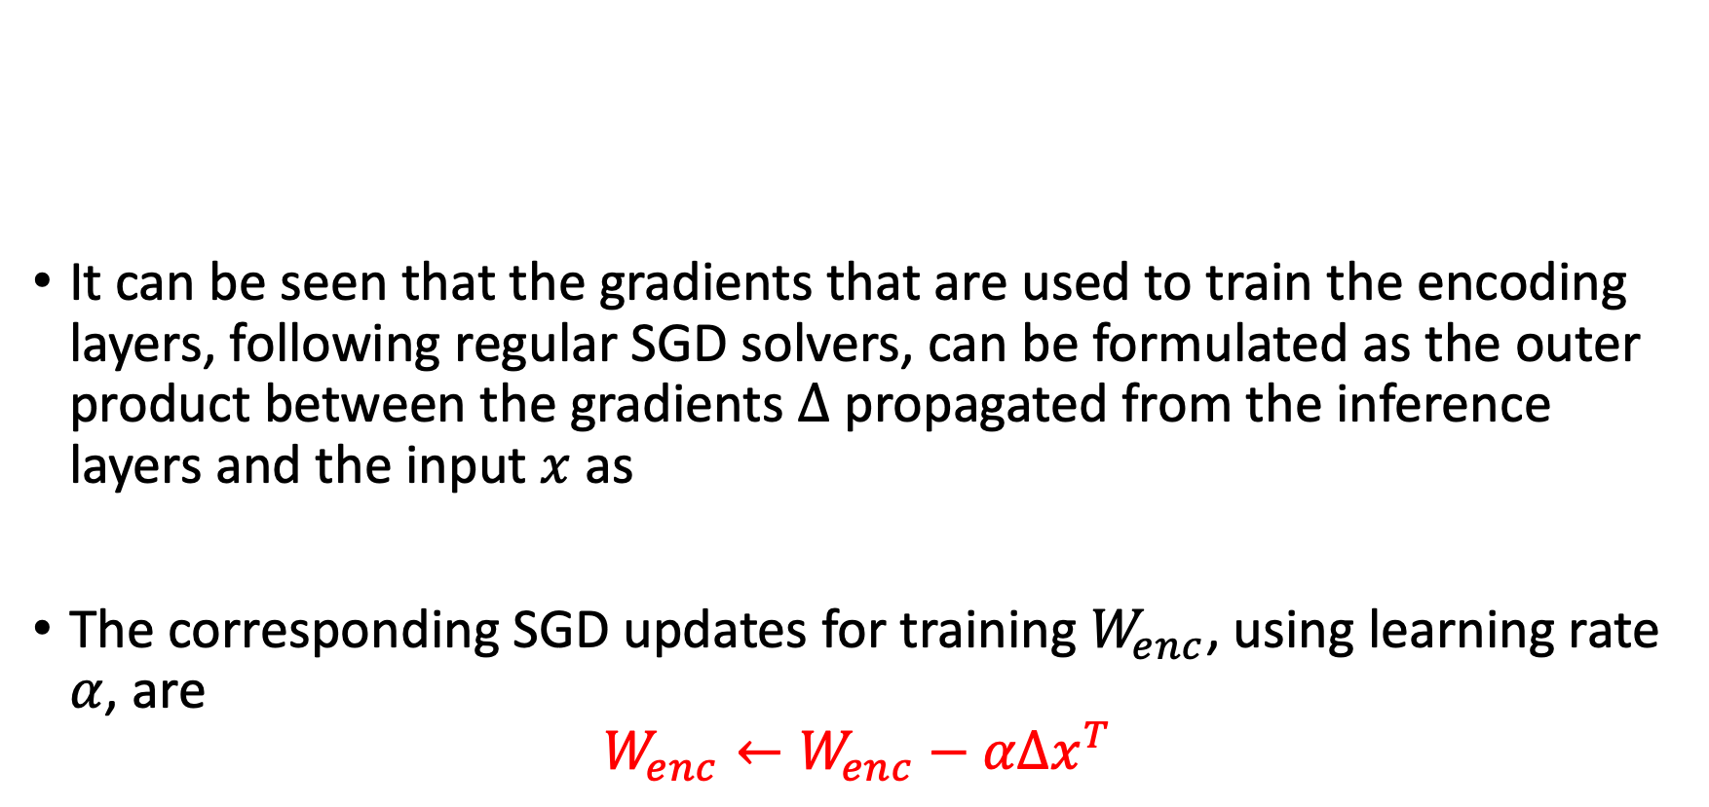
Gradient Importance
It can be seen that the gradients that are used to train the encoding layers, following regular SGD solvers, can be formulated as the outer product between the gradients $Δ$ propagated from the inference layers and the input $x$ as
The corresponding SGD updates for training $W_{enc}$, using learning rate $α$, are
$$W_{enc}←W_{enc}−αΔx^{T}$$
Notes:
From this proposition
In the following proposition, we show that the gradients of some commonly used loss functions, E(^y; y), such
as cross entropy or mean squared errors, w.r.t. W1, can be formulated in the form of an
outer product. The proof and details can be found in Appendix E.

Slide 12
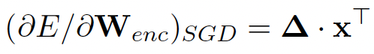
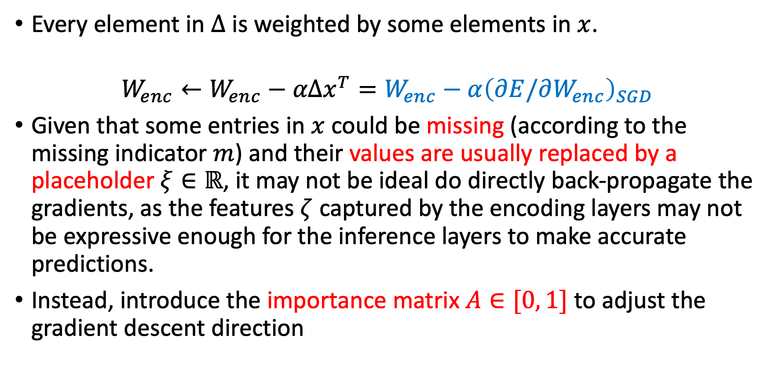
Gradient Importance
Every element in $Δ$ is weighted by some elements in $x$.
$$W_{enc}←W_{enc}−αΔx^{T}={W_{enc}−α\left(∂E/∂W_{enc}\right)}_{SGD}$$
Given that some entries in $x$ could be missing (according to the missing indicator $m$) and their values are usually replaced by a placeholder $ξ∈ℝ$, it may not be ideal do directly back-propagate the gradients, as the features $ζ$ captured by the encoding layers may not be expressive enough for the inference layers to make accurate predictions.
Instead, introduce the importance matrix $A∈[0, 1]$ to adjust the gradient descent direction
Notes:
the gradients used to train the encoding layers, following regular SGD solvers, can be formulated as
The corresponding SGD updates for training $W_{enc}$, using learning rate $α$, are
Instead, we consider introducing the importance matrix A 2 [0; 1]e d to adjust the gradient descent direction

Slide 13
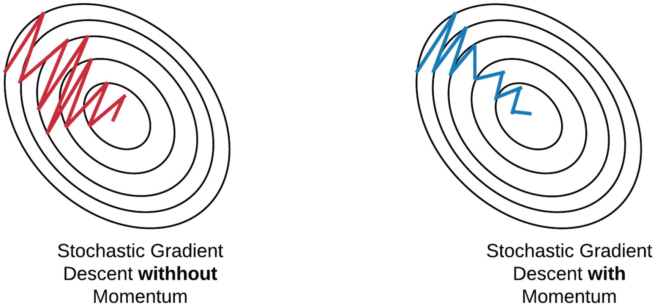
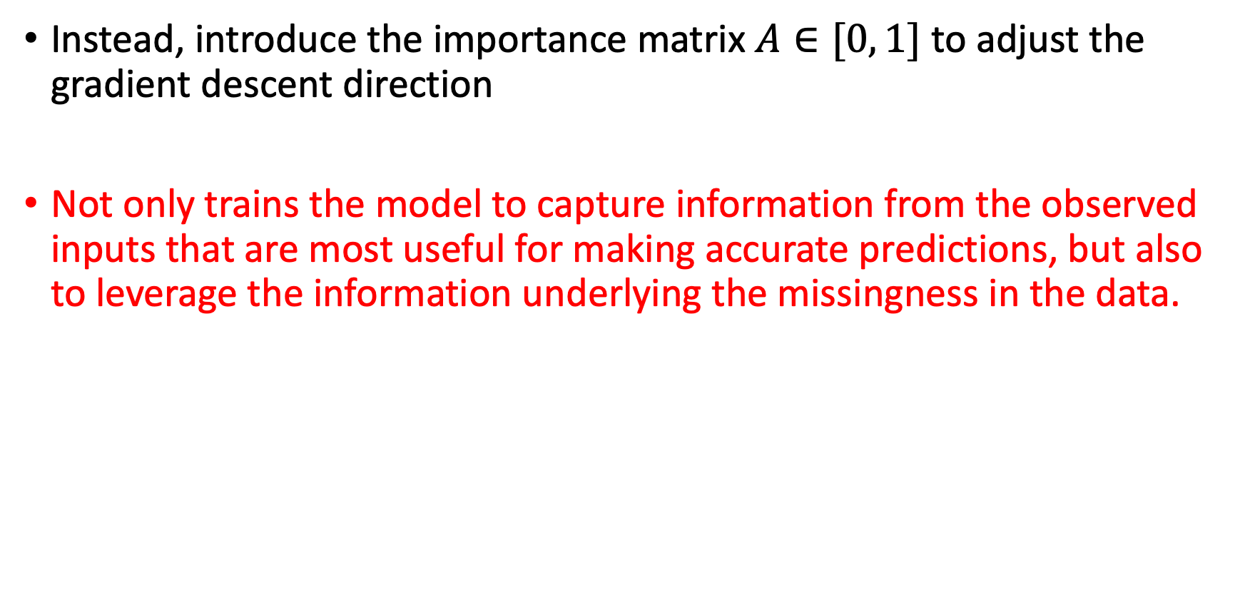
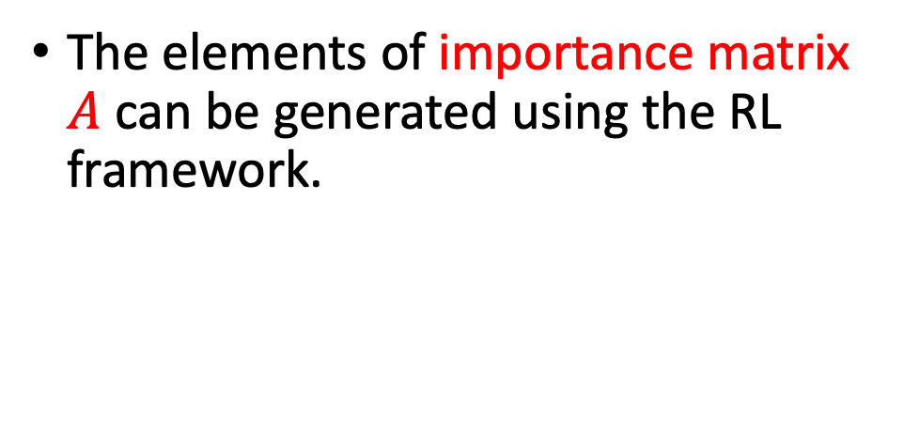
Gradient Importance
Instead, introduce the importance matrix $A∈[0, 1]$ to adjust the gradient descent direction
Not only trains the model to capture information from the observed inputs that are most useful for making accurate predictions, but also to leverage the information underlying the missingness in the data.
The elements of importance matrix $A$ can be generated using the RL framework.
Notes:
the gradients used to train the encoding layers, following regular SGD solvers, can be formulated as
The corresponding SGD updates for training $W_{enc}$, using learning rate $α$, are
Instead, we consider introducing the importance matrix A 2 [0; 1]e d to adjust the gradient descent direction as

Slide 14
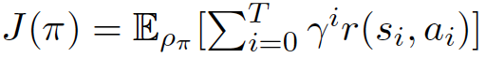
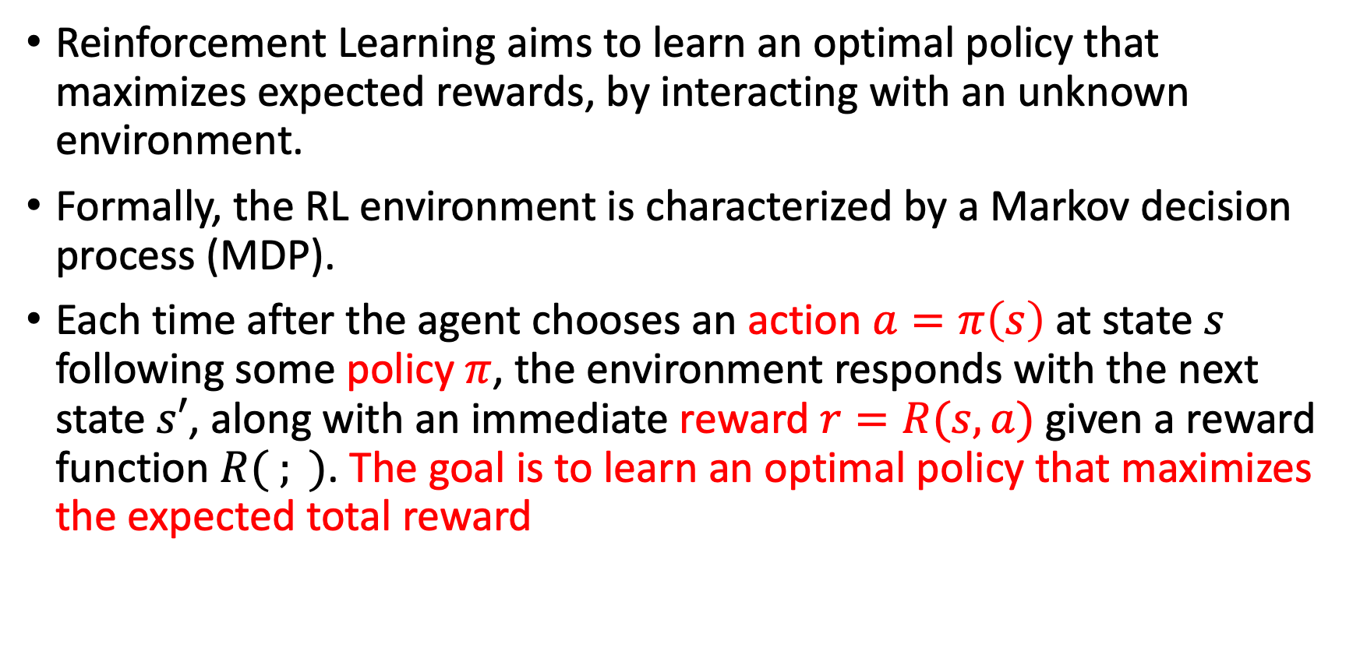
RL to Generate Importance Matrix
Reinforcement Learning aims to learn an optimal policy that maximizes expected rewards, by interacting with an unknown environment.
Formally, the RL environment is characterized by a Markov decision process (MDP).
Each time after the agent chooses an action $a=π\left(s\right)$at state $s$ following some policy $π$, the environment responds with the next state $s′$, along with an immediate reward $r=R(s,a)$given a reward function $R( ; )$. The goal is to learn an optimal policy that maximizes the expected total reward
Notes:
T is the horizon of the MDP,
\gamma [0; 1) is the discounting factor
\rho is the sequence of states and actions drawn from the trajectory distribution determined by \pi
during the running of a computer program without interrupting the run.

Slide 15
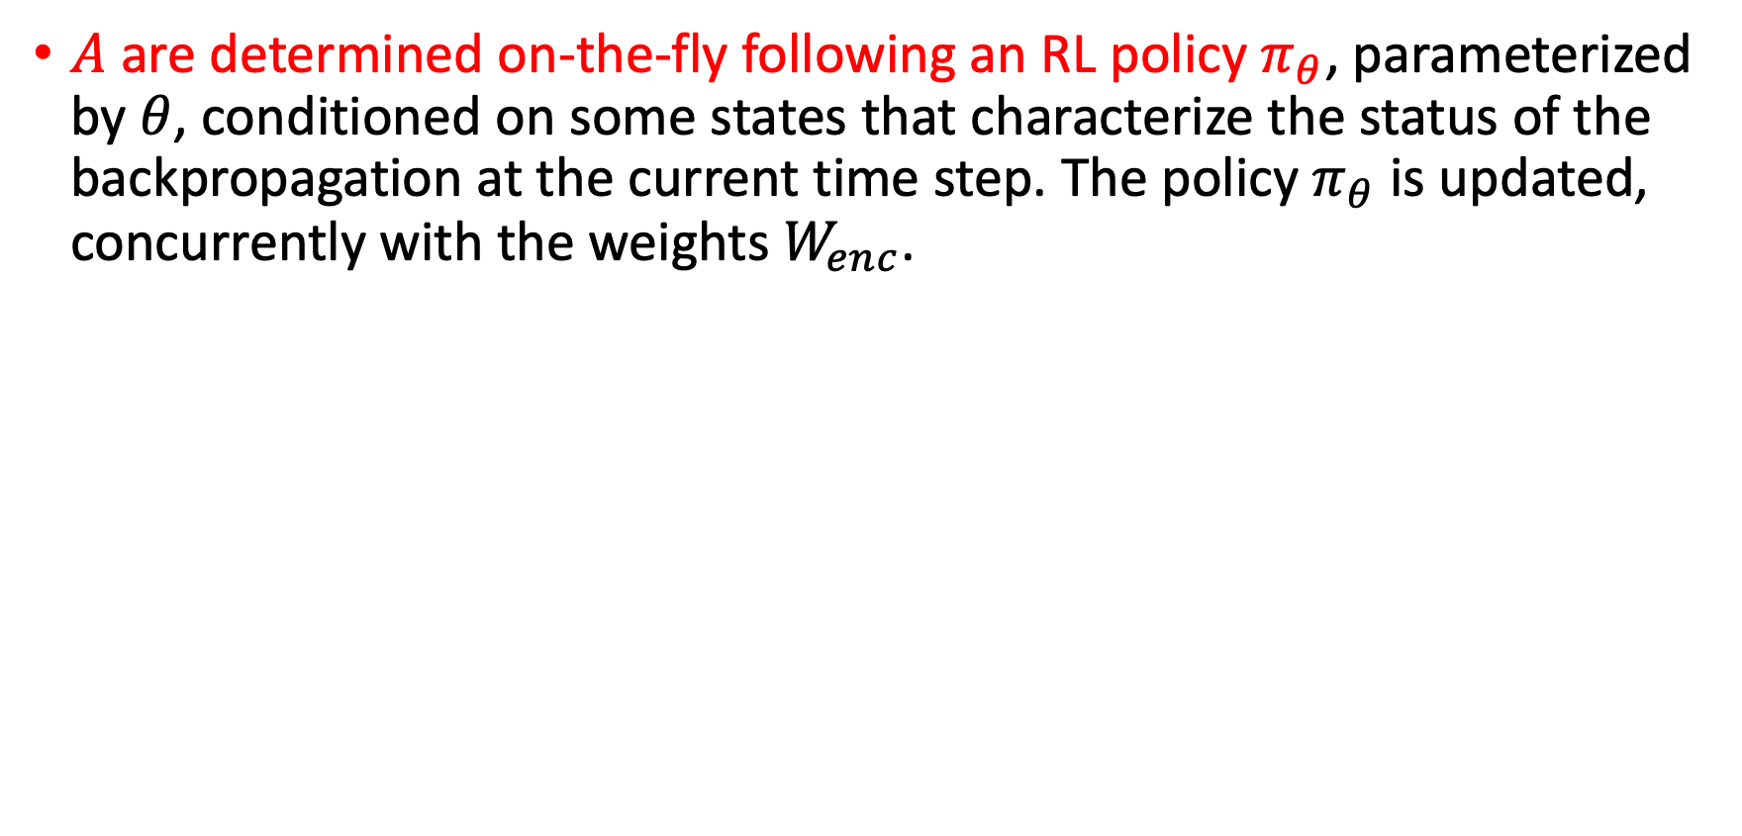
RL to Generate Importance Matrix
$A$ are determined on-the-fly following an RL policy $π_{θ}$, parameterized by $θ$, conditioned on some states that characterize the status of the backpropagation at the current time step. The policy $π_{θ}$ is updated, concurrently with the weights $W_{enc}$.
Notes:
On the fly: during the running of a computer program without interrupting the run.
State Space $S$. The state space characterizes the agent’s knowledge of the environment at each time step.
$s=(x;m;ζ;\hat{y})$
4-tuple
the outputs of the encoding layer of MLPs or the hidden states ht of LSTMs,
current training input $x∈ℝ^{d}$
the missing indicator $m∈ℝ^{d}$
the feature$ζ$
the predictions $\hat{y}$ produced by the inference layers
T is the horizon of the MDP,
\gamma [0; 1) is the discounting factor
\rho is the sequence of states and actions drawn from the trajectory distribution determined by \pi
Reinforcement Learning aims to learn an optimal policy that maximizes expected rewards, by interacting with an unknown Environment.
by an RL agent that interacts with the back-propagation process modeled as the MDP defined as $M= (S;A;P;R;γ)$

Slide 16
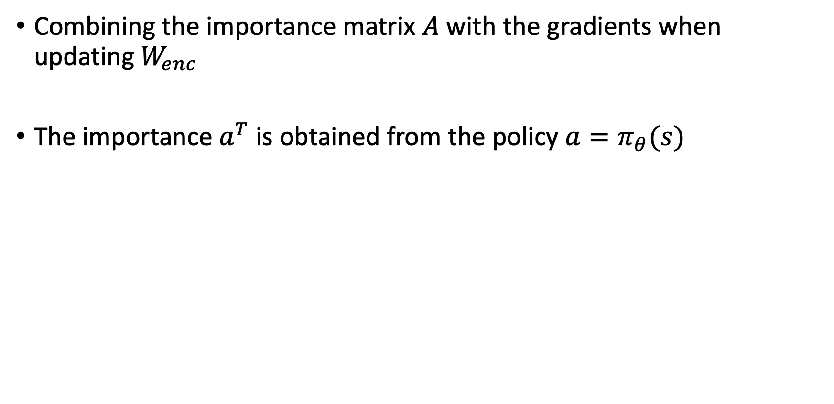
RL to Generate Importance Matrix
Combining the importance matrix $A$ with the gradients when updating $W_{enc}$
The importance $a^{T}$ is obtained from the policy $a=π_{θ}(s)$

Slide 17
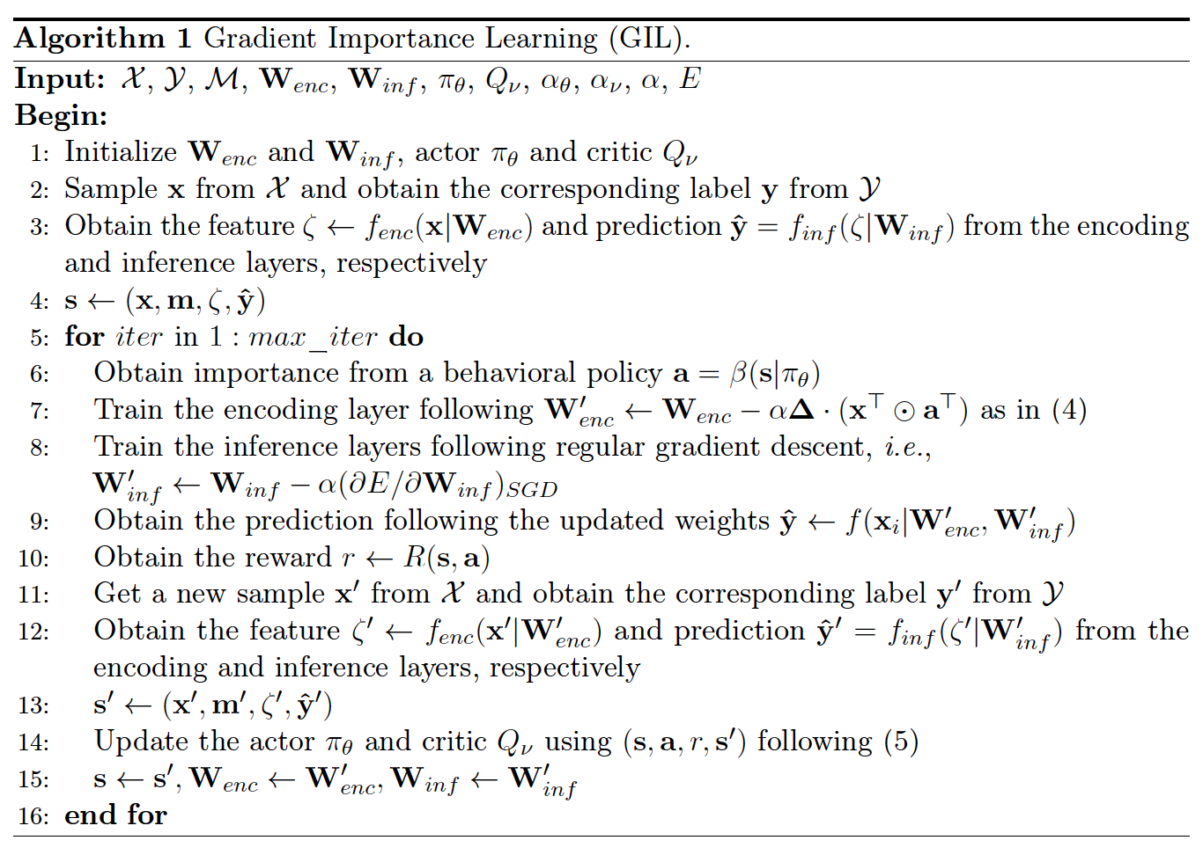
RL to Generate Importance Matrix

Slide 18
Datasets
i) MIMIC-III (Johnson et al., 2016) that consists of real-world EHRs obtained
ii) A de-identified ophthalmic patient dataset obtained from an eye center in North America
iii) Hand-written digits MNIST (LeCun and Cortes, 2010)
Also tested on a smaller scaled ICU time-series from 2012 Physionet challenge (Silva et al., 2012)
Proposed method not only outperforms the baselines on all three datasets under various experimental settings, but also offers better feature representations.
Notes:
They evaluate the performance of the imputation-free prediction models trained by GIL against the existing imputation-prediction paradigm on both benchmark and real-world datasets.
Imputation stage employs both state-of-the-art and classic imputation algorithms
They also consider variations of the GIL method proposed in Section 2 to illustrate its robustness and flexibility.
We also tested on a smaller scaled ICU time-series from 2012 Physionet challenge (Silva et al., 2012) and these results can be found in Appendix D.4.
Some of the data are augmented with additional missingness to ensure sufficient missing rates and the
datasets we use cover all types of missing data, i.e., missing complete at random (MCAR), MAR and MNAR (Little and Rubin, 2019).
We found that the proposed method not only outperforms the baselines on all three datasets under various experimental settings, but also offers better feature representations as shown in Figure 3.
We start with an overview of the baseline methods, in the following sub-section, and then proceed to present our experimental findings.

Slide 19
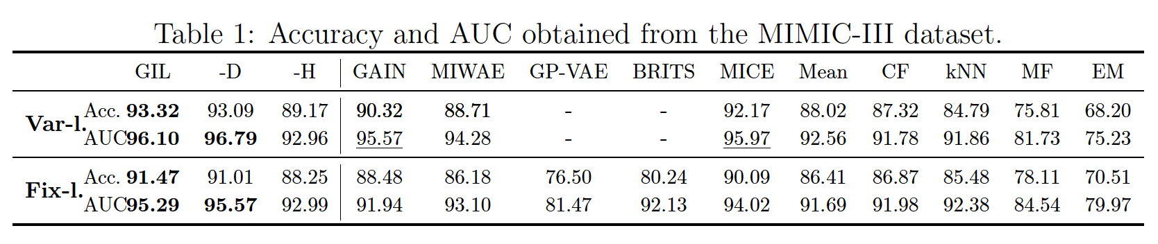
MIMIC-III
Predict if a patient will develop septic shock in the next 4-hour window; Overall missing rate is 71.63%
When varied-length sequences are considered, GIL(-D) slightly outperforms GAIN and MICE while it significantly dominates the other baseline methods.
When fixed-length sequences are considered, GAIN and MICE’s performance decreases dramatically and are significantly dominated by that of GIL(-D).
Notes:
Use 14 commonly-utilized vital signs and lab results over a 2-hour observation window to predict whether a patient will develop septic shock in the next 4-hour window
We consider the early prediction of septic shock using the MIMIC-III dataset, following the
frameworks provided in recent data-driven works for data pre-processing (Sheetrit et al., 2017;
Fleuren et al., 2020; Khoshnevisan et al., 2020).
The resulting dataset used for training and
testing contains 2,166 sequences each of which has length between 3 and 125, and the overall
missing rate is 71.63%; the missing data in this dataset can be considered as a mixture of
MCAR, MAR and MNAR. More details can be found in Appendix D.1.
varied-length sequences (Var-l.) obtained in above, we also test with a fixed-length version (Fix-l.)
When varied-length sequences are considered, GIL(-D) slightly outperforms GAIN and MICE while it significantly
dominates the other baseline methods. However, when fixed-length sequences are considered,
GAIN and MICE’s performance decreases dramatically and are significantly dominated by
that of GIL(-D). This could be caused by omitting the records beyond the 8-th time step as
both models are flexible enough to capture such information from that point on-wards, while
in contrast, the performance increases for kNN, MF and EM which are in general based on
much simpler models.

Slide 20
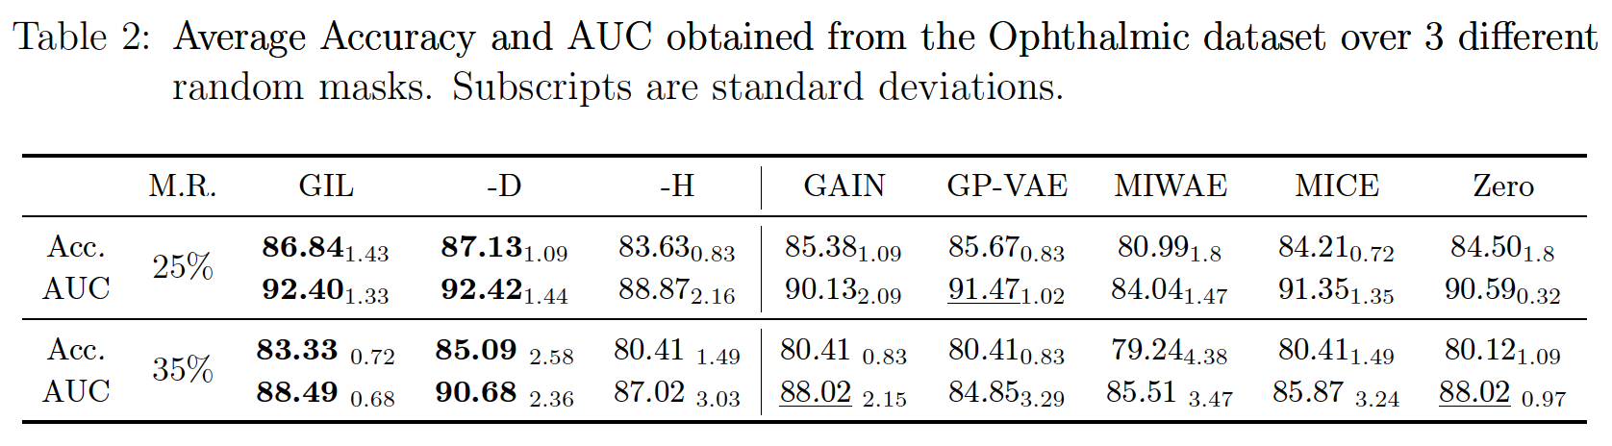
Ophthalmic Data
Consider identifying diabetic retinopathy (DR), an eye disease caused by diabetes.
Apply additional random masks over both the input image features and demographic/diabetic information to increase the missing rate to 25% and 35%
When the missing rate increases to 35%, GIL-D outperforms all the other methods
Notes:
using the de-identified data obtained from an eye clinic constituted by a mixture of image feature vectors and tabular information.
We apply additional random masks over both the input image features (by assuming one or two entire image feature vectors are missing) and
demographic/diabetic information (by assuming some entries are missing) to increase the
missing rate to 25% and 35%, where for each case 3 different random masks are applied.
For this experiment we consider an MLP with 2 hidden layers with 1,000 nodes each for
prediction. The results are shown in Table 2 where the mean and standard deviations (in
subscripts) of accuracy and AUC are reported.
Although GIL and GP-VAE result in similar performance in the 25% missing rate case, GIL still achieves higher accuracy and AUC; these
are significantly improved, with significantly lower standard deviation over GP-VAE, when
the missing rate increases to 35%. In general, GIL-D outperforms all the other methods,
with an exception of the higher standard deviation of accuracy in the 35% M.R. case, which
benefits from the flexibility of the framework we proposed. With increased missingness,
the performance of most baselines drops significantly and are close to the zero-imputation
baseline as the image feature vectors occupy most dimensions of the inputs while imputing
with zeros would be a reasonable heuristic.

Slide 21
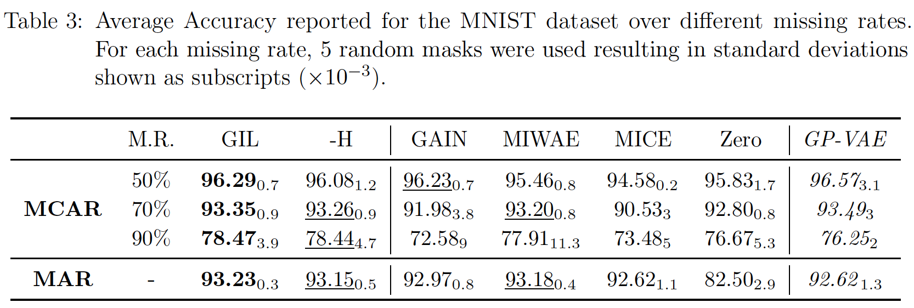
MNIST
The MCAR version of MNIST where a pre-determined portion of pixels (i.e., out of 50%, 70% and 90%) are masked off uniformly at random from the original images
The MAR version: assumes part of the image is always observable and the positions of missing pixels are determined by a distribution conditioned on features extracted from the observable portion
Notes:
Note that in the MCAR setting, GP-VAE achieves slightly higher
average accuracy than our method when 50% and 70% of the pixels missing, because it
relies on convolutional encoding layers, which intrinsically have advantages on this dataset.
However, GP-VAE’s performance is associated with higher standard deviation in both cases
and is significantly outperformed by our method when 90% pixels are missing. The models
trained by GIL also significantly outperforms the baselines following the imputation-prediction
framework. This suggests that most of the IAs fail to reconstruct the input data when the
missing rate is high Moreover, the errors produced during the imputation are
then propagated into the prediction step which results in the inferior performance. In the
MAR setting, the task becomes more challenging as entire rows of pixels could be missing.
Finally, the model trained by GIL outperforms most of the baselines depending on IAs with
an exception of MIWAE, which only slightly outperforms it. Note that GIL-H’s performance
is close to GIL in most of the settings due to the simple structure of the MNIST digits where
the missing indicator m could be a good estimation of the importance a.

Slide 22
MNIST
Most of the IAs fail to reconstruct the input data when the missing rate is high
The model trained by GIL outperforms most of the baselines depending on IAs with an exception of MIWAE, which only slightly outperforms it.
Notes:
Note that in the MCAR setting, GP-VAE achieves slightly higher
average accuracy than our method when 50% and 70% of the pixels missing, because it
relies on convolutional encoding layers, which intrinsically have advantages on this dataset.
However, GP-VAE’s performance is associated with higher standard deviation in both cases
and is significantly outperformed by our method when 90% pixels are missing. The models
trained by GIL also significantly outperforms the baselines following the imputation-prediction
framework. This suggests that most of the IAs fail to reconstruct the input data when the
missing rate is high Moreover, the errors produced during the imputation are
then propagated into the prediction step which results in the inferior performance. In the
MAR setting, the task becomes more challenging as entire rows of pixels could be missing.
Finally, the model trained by GIL outperforms most of the baselines depending on IAs with
an exception of MIWAE, which only slightly outperforms it. Note that GIL-H’s performance
is close to GIL in most of the settings due to the simple structure of the MNIST digits where
the missing indicator m could be a good estimation of the importance a.
Following from Section 2.4,
we also test on binary classification tasks using GIL-D which includes the distributional
difference term D( +; ), captured by mean squared errors, into the reward function. For
baselines, we start with another variant of GIL that uses a simple heuristic – the missing
indicator m – to replace the importance a in GIL; we denote it as GIL-H. This helps analyze
the advantages of training the models using the importance obtained from the RL policy
learned by GIL, versus a heuristic that simply discards the gradients produced by the subset
of input entries that are missing.

Slide 23
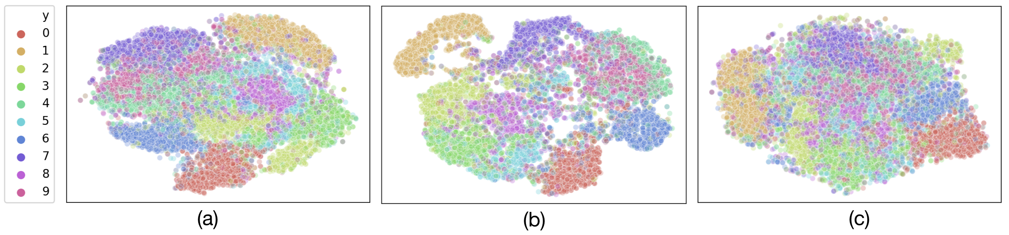
Feature Space Visualization
Proposed method not only outperforms the baselines on all three datasets under various experimental settings, but also offers better feature representations.
Use t-distributed stochastic neighbor embedding (t-SNE) to visualize the features. GIL results in more expressive features than the others as it generates clusters with clearer boundaries.
(a) GIL, (b) MIWAE and (c) GAIN on the MNIST dataset with 90% missing rate.
Notes:
We consider identifying diabetic retinopathy (DR), an eye disease caused by diabetes,
using the de-identified data obtained from an eye clinic constituted by a mixture of image
We found that the proposed method not only outperforms the baselines on all three datasets under various experimental settings, but also offers better feature representations as shown in Figure 3.
We start with an overview of the baseline methods, in the following sub-section, and then proceed to present our experimental findings.
learned by the prediction model trained by (a) GIL compared to (b) MIWAE and (c) GAIN.

Slide 24
Thank you
Any questions?

